Slide 1

Facial Emotion & Behavior Detection using Deep Learning (GUI – Based)
School of C&IT
Under Guidance of:
Prof. Raghavendra Reddy
Presented By:
Bindu Bhargava Reddy Chintam – R17CS080
Maram Venkata NagaSai Teja – R17CS229
M Sumanth – R17CS210
Lokireddy Sai Siddardha Reddy – R17CS208

Slide 2
Contents
Abstract
Introduction
Literature Survey
Problem Statement
Proposed Work/ Methodology Used
Results and Discussions
Conclusion
References

Slide 3
ABSTRACT

Slide 4
Machine Learning Algorithms are used to implement the proposed to identify social distance, face masks, drowsiness detection, age-gender detection and emotion detection.
In the proposed model, we are using machine learning techniques such as Linear discriminant Analysis (LDA), Independent Component Analysis (ICA), Principle Component Analysis (PCA) for age-gender detection and emotion detection, K-Nearest Neighbors (KNN) for Social Distancing, and Support Vector Machine (SVM) for face mask detection and drowsiness detection.
The resultant average accuracy of all the models is 96.3% which is capable to predict various tasks.

Slide 5
INTRODUCTION

Slide 6
As per the current situation, the COVID-19 is still prevailing all over the world. As per the WHO report, 136 million people got affected till march 2021 and out of which 2.9 million people died. Many people all around the globe are still facing challenges.
In Similar terms, drowsiness of driver while driving causes lots of accidents in and around the world. As per the FARS survey, 63% of accidents were due to drowning while driving for the past 2 years.

Slide 7
Human facial expressions are a common and straightforward way to communicate feelings and thoughts, particularly in nonverbal communication.
To solve these issues, we do need a system that helps to prevent losses and gain features from resources.

Slide 8
LITERATURE SURVEY

Slide 9
Ref No. | Approach | Advantages | Limitations | Accuracy
[1] | CNN | Intermitted CNN. | Fails capture in low light conditions. | 93.2%
[2] | Open-CV and SVM | Works in bright backgrounds. | Fails while wearing glasses. | 89.2
[3] | 3D-CNN with HMM. | Detects both images and videos. | Fails to detect multiple faces. | 91.5%
[4] | R-CNN. | Works even in-crowd. | Fails in dark background. | 95.2%
[5] | CNN and LDA. | Detects multiple faces. | Scope to improve Accuracy. | 85.3%

Slide 10
PROBLEM STATEMENT

Slide 11
Current problem is with COVID-19 which affected all around the world. Social Distancing and Face Mask is only the solution to prevent this pandemic situation in and around you and wide spreading. In order to monitor everyone in and around is extremely impossible. Similarly, most of the road accidents were recorded only due to negligence of driver’s drowsiness and distraction.
Human facial expressions are natural and direct means to communicate the emotions and intentions, especially in non-verbal communications. Age and gender, two of the key facemask attributes, play a very initial role in social communications.

Slide 12
Desired solution in order to crisscross this we need a high- level Sophisticated Deep learning model to train and implement to monitor the above said problem states. Efficiency here matter a lot and performance is a major factor that plays a vital role in multitasking.

Slide 13
PROPOSED WORK / METHODOLOGY USED

Slide 14
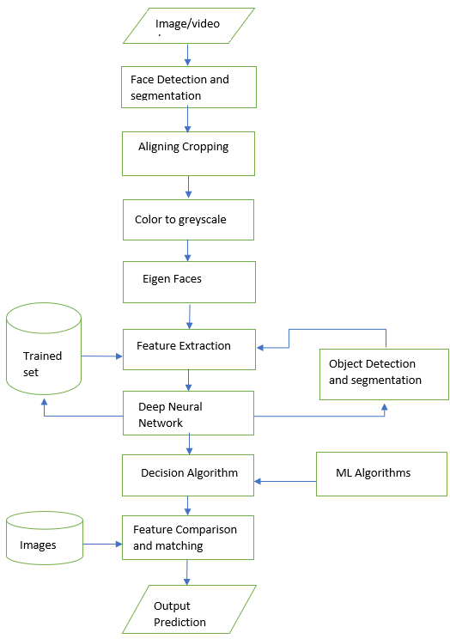
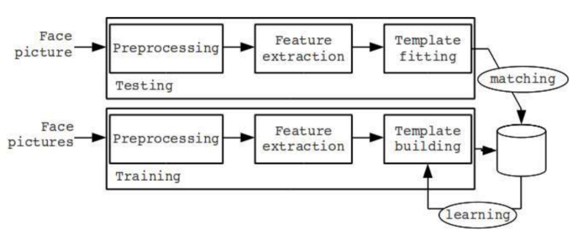
Methodology
The Architecture of Proposed System:
Preprocessing
Training Model
Deep Neural Networks
Prediction of O/P

Slide 15
We are performing various tasks Face Mask Detection, Social Distance Detection, Emotion Detection, Drowsiness Detection, and Age-Gender Detection. Face Mask Detection is done by using Region-based Convolutional Neural Networks (R-CNN) image processing algorithm. Social Distance Detection is implemented by using KNN.
In Gender Detection, as there are 2 genders to identify as they belong to different class.

Slide 16
Hence, we use SVM. For Age prediction, we use multi-label classification and multi-class classification techniques SVM.
For drowsiness detection, we consider eyes that are completely open by excluding all closed and partially closed eyes. It is implemented by using logistic regression.

Slide 17
Implementation
Step 1: Input Face Images, Videos, stream
Step 2: Preprocessing the Face Images
2.1 Face Detection and Segmentation
2.2 Aligning & Cropping
2.3 Color to Grayscale
2.4 Eigen Faces
2.5 Capturing Features
Step 3: Feature Extraction from Images
3.1 Feature-based /Appearance-based approach
3.2 Object detection and template building (Testing)
3.3 Matching with trained dataset utilizing CPU (GPU, if available)
3.4 improving trained dataset (Training)
Step 4: Classification Methods
4.1 Binary Classification or Multi-label classification
4.2 Decision Algorithm
Step 5: Final Prediction with an output frame

Slide 18
RESULTS AND DISCUSSIONS

Slide 19
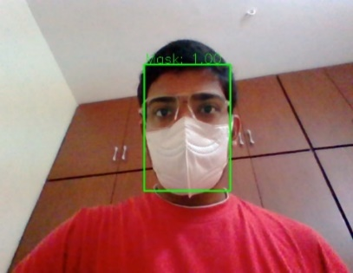
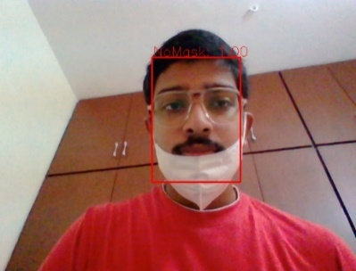
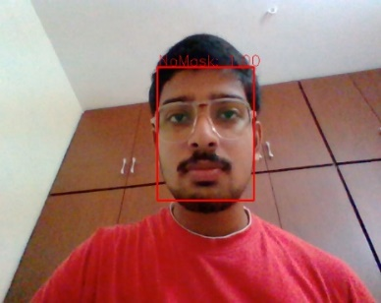
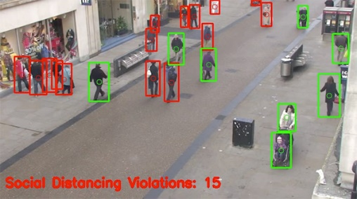
Results
Face Mask Detection =>>
Social Distance Detection =>>

Slide 20
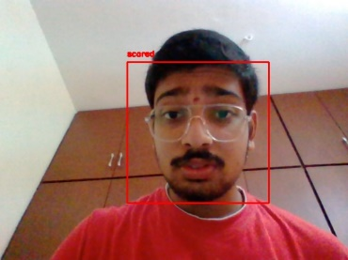
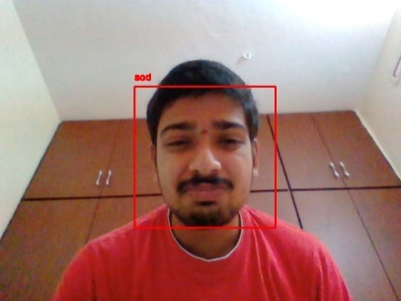
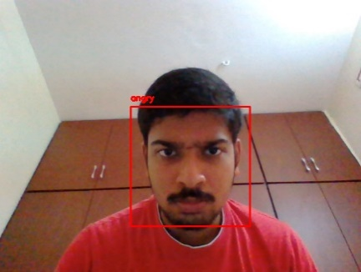
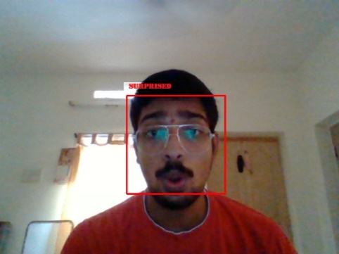
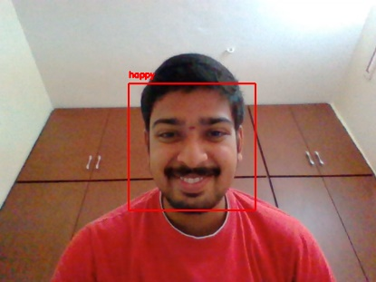
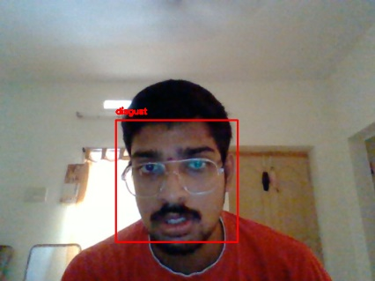
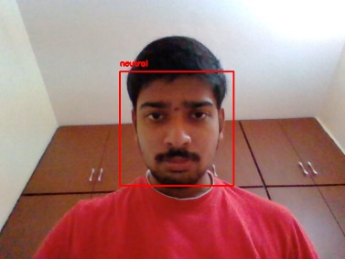
Results
Emotion Detection =>>

Slide 21
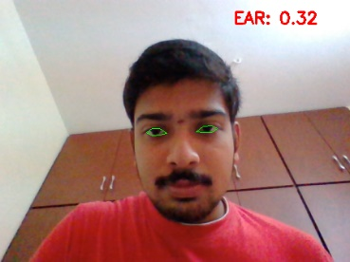
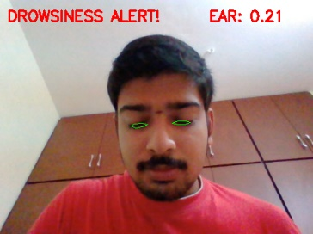
RESULTS
Drowsiness Detection =>>

Slide 22
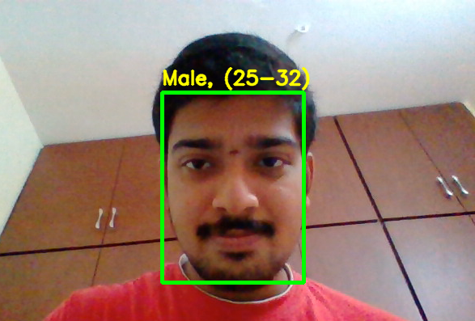
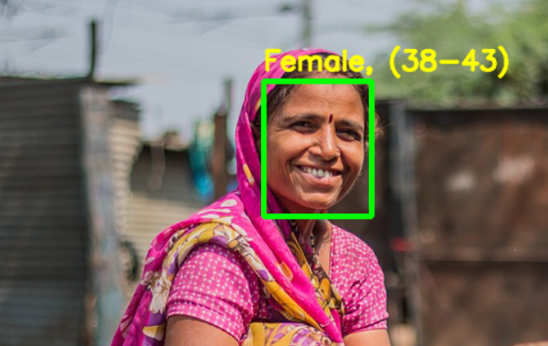
Results
Age & Gender Detection =>>

Slide 23
CONCLUSION

Slide 24
Conclusion & Continuation
We finally Conclude that, our model is more efficient in performing multitasks with higher rate in accuracy.
This model could help 70% of present industry in order to perform tasks of Monitoring and Guiding the activities. Hence, this could enhance and grep the modern era of technology to find redundancy and relatively takes action accordingly.
We strongly say that our model could deliver information of Social Distancing, Emotion detection, Gender/Age Classification, Driver Drowsiness and Suspicious Activities together with an accuracy of ~96.4% respectively.
This model could motivate large scale of industries to implement and manage them accordingly in order to maintain reliability and robustness.

Slide 25
Cont.
We would to like improve and sort our algorithms to make it more accurate in upcoming days.
We would like add few addons that could deliberately improve our model on both sides:
Trust & Security
Improve hardware config’s: GPU Enhancement
Algorithm Tuning: Improving Stability
Feature Engineering: More Refined and Accurate

Slide 26
REFERENCES

Slide 27
References
[1] M. ASJID TANVEER1 , M. JAWAD KHAN1 , M. JAHANGIR QURESHI2 “Enhanced Drowsiness Detection Using Deep Learning: An NIRS Study”, Received August 5, 2019, accepted September 6, 2019, date of publication September 23, 2019, date of current version October 3, 2019
[2] Rajesh Kumar G A1 , Ravi Kant Kumar2 , Goutam Sanyal3 “Facial Emotion Analysis using Deep Convolution Neural Network” International Conference on Signal Processing and Communication (ICSPC’17) – 28th & 29th July 2017.
[3] Alavudeen Basha A, Parthasarathy P “Detection of Suspicious Human Activity based on CNN-DBNN Algorithm for Video Surveillance Applications” 2019 Innovations in Power and Advanced Computing Technology (i-PACT).
[4] Li Fei, Wang Yajie, Qiu Hongkun, Wang Linlin “Gender Identification Using SVM Based on Human Face Images” 2018 International Conference on Virtual Reality and Visualization.

Slide 28
Cont.
[5] Akriti Jaiswal, A. Krishnama Raju, Suman Deb” Facial Emotion Detection Using Deep Learning”, 2020 International Conference for Emerging Technology (INCET) Belgaum, India. Jun 5-7, 2020.
[6] Insha Rafique, Awais Hamid, Sheraz Naseer” Age and Gender Prediction using Deep Convolutional Neural Networks”, 2019 International Conference on Innovative Computing (ICIC).
[7] Bhargava Reddy, Ye-Hoon Kim, Sojung Yun, Chanwon Seo, Junik Jang” Real-time Driver Drowsiness Detection for Embedded System Using Model Compression of Deep Neural Networks” 2017 IEEE Conference on Computer Vision and Pattern Recognition Workshops.
[8] Amrutha C.V, C. Jyotsna, Amudha J.” Deep Learning Approach for Suspicious Activity Detection from Surveillance Video” Proceedings of the Second International Conference on Innovative Mechanisms for Industry Applications (ICIMIA 2020) IEEE Xplore Part Number: CFP20K58-ART; ISBN: 978-1-7281-4167-1.

Slide 29
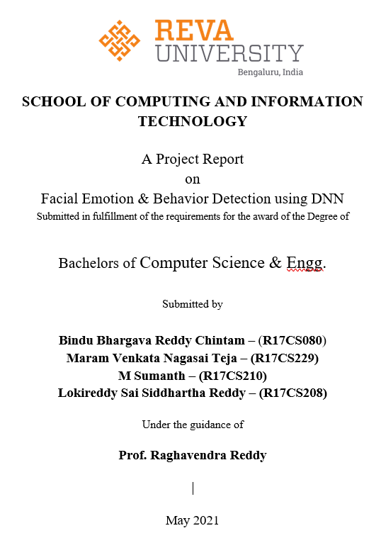
REPORT PREPARATION

Slide 30
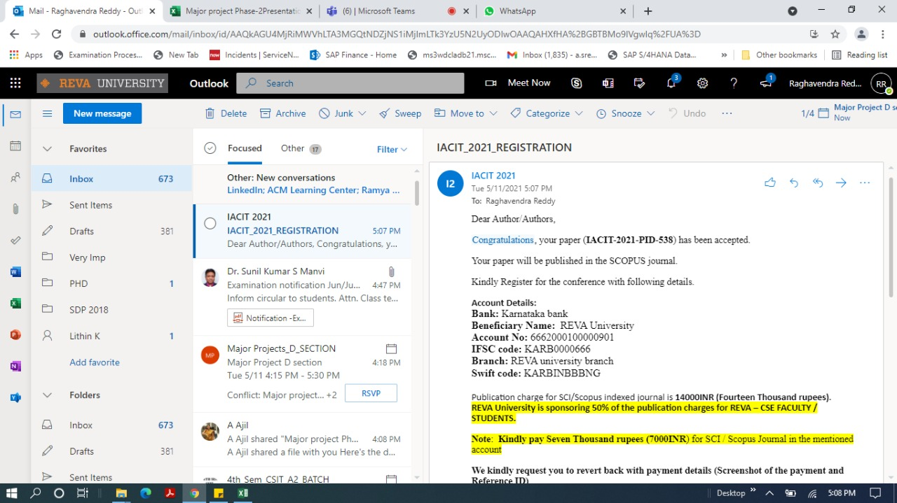
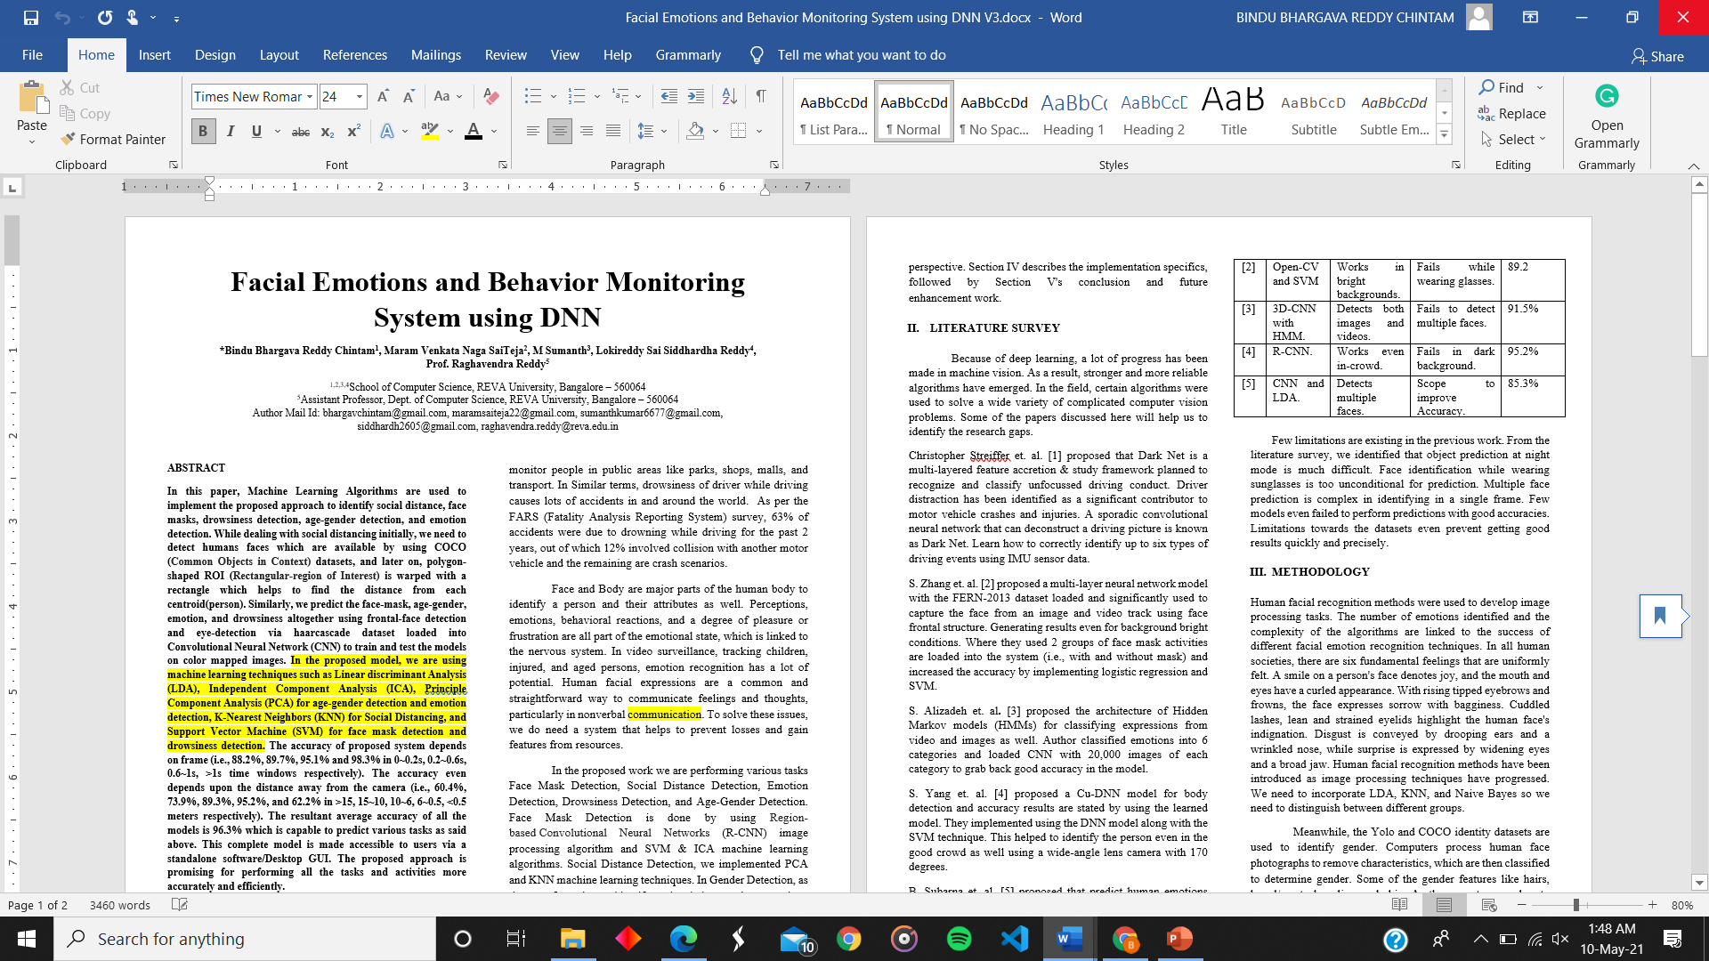
PAPER & PATENT PREPARATION

Slide 31
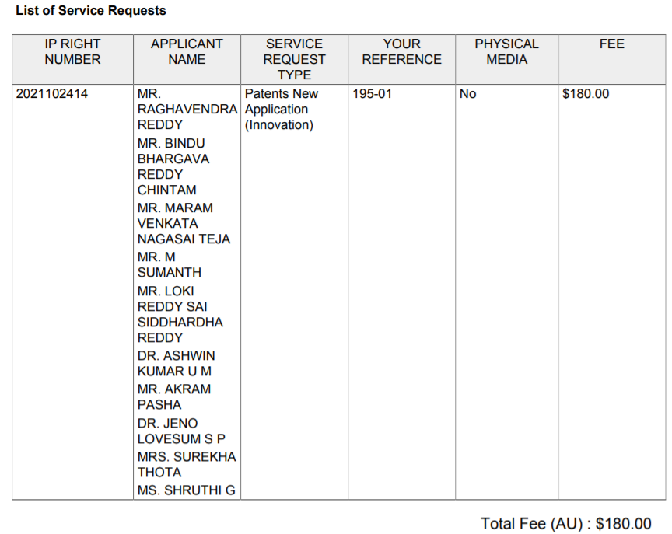
PAPER & PATENT PREPARATION
Title:
A SYSTEM AND METHOD FOR MONITORING FACIAL EMOTIONS AND BEHAVIOR USING DEEP NEURAL NETWORK
Application Number: 2021102414

Slide 32
THANK YOU

